Slide 1

Go, change the world
RV College of
Engineering
Course Code:22MCE22TL
Advances in Operating System
Unit 3
Threads API

Slide 2

Go, change the world
Condition variables
RV College of
Engineering
Condition variables are useful when some kind of signaling must take place between threads, if one thread is waiting for another to do something before it can continue.
Two primary routines are used by programs wishing to interact in this way:
int pthread_cond_wait(pthread_cond_t *cond, pthread_mutex_t *mutex);
int pthread_cond_signal(pthread_cond_t *cond);
To use a condition variable, one has to in addition have a lock that is associated with this condition. When calling either of the above routines, this lock should be held.
The first routine, pthread cond wait(), puts the calling thread to sleep, and thus waits for some other thread to signal it, usually when something in the program has changed that the now-sleeping thread might care about.
A typical usage looks like this:
pthread_mutex_t lock = PTHREAD_MUTEX_INITIALIZER;
pthread_cond_t cond = PTHREAD_COND_INITIALIZER;
Pthread_mutex_lock(&lock);
while (ready == 0)
Pthread_cond_wait(&cond, &lock);
Pthread_mutex_unlock(&lock);

Slide 3
Go, change the world
RV College of
Engineering
Condition variables
After initialization of the relevant lock and condition, a thread checks to see if the variable ready has yet been set to something other than zero. If not, the thread simply calls the wait routine in order to sleep until some other thread wakes it.
Code to wake a thread, which would run in some other thread, looks like this:
Pthread_mutex_lock(&lock);
ready = 1;
Pthread_cond_signal(&cond);
Pthread_mutex_unlock(&lock);
Note, when signaling (as well as when modifying the global variable ready), make sure to have the lock held. This ensures that a race condition in the code is not accidently introduced.
Also, the wait call takes a lock as its 2nd parameter, whereas the signal call only takes a condition, because the wait call, in addition to putting the calling thread to sleep, releases the lock when putting said caller to sleep.
Otherwise, how the other thread acquire the lock and signal it to wake up? However, before returning after being woken, the pthread cond wait() re-acquires the lock, thus ensuring that any time the waiting thread is running between the lock acquire at the beginning of the wait sequence, and the lock release at the end, it holds the lock.

Slide 4
Go, change the world
RV College of
Engineering
Condition variables
Lastly, the waiting thread re-checks the condition in a while loop, instead of a simple if statement. In general, using awhile loop is the simple and safe thing to do. Although it rechecks the condition (perhaps adding a little overhead), there are some pthread implementations that could spuriously wake up a waiting thread; in such a case, without rechecking, the waiting thread will continue thinking that the condition has changed even though it has not. It is safer thus to view waking up as a hint that something might have changed, rather than an absolute fact.
Sometimes it is tempting to use a simple flag to signal between 2 threads, instead of a condition variable and associated lock.
For example, we could rewrite the waiting code above to look more like this in the waiting code:
while (ready == 0)
; // spin
The associated signaling code would look like this:
ready = 1;
This should be avoided, for the following reasons:
It performs poorly in many cases (spinning for a long time just wastes CPU cycles).
It is error prone. As recent research shows, it is easy to make mistakes when using flags (as above) to synchronize between threads; roughly half the uses of these ad hoc synchronizations were buggy!

Slide 5
Go, change the world
THREAD API GUIDELINES
RV College of
Engineering
• Keep it simple. Any code to lock or signal between threads should be as simple as possible. Tricky thread interactions lead to bugs.
• Minimize thread interactions. Keep the number of ways in which threads interact to a minimum. Each interaction should be carefully thought out and constructed with tried and true approaches
• Initialize locks and condition variables. Failure to do so will lead to code that sometimes works and sometimes fails in very strange ways.
• Check return codes. Check each and every return code, failure to do so will lead to bizarre and hard to understand behavior.
• Be careful with how arguments are passed to, and return values from, threads. In particular, any time you are passing a reference to a variable allocated on the stack, you are probably doing something wrong.
• Each thread has its own stack. As related to the point above, each thread has its own stack. Thus, if any locally-allocated variable inside of some function a thread is executing, it is essentially private to that thread; no other thread can (easily) access it. To share data between threads, the values must be in the heap or otherwise some locale that is globally accessible.
• Always use condition variables to signal between threads. While it is often tempting to use a simple flag.

Slide 6
Go, change the world
Locks
RV College of
Engineering
The Basic Idea
As an example, assume critical section looks like this, the canonical update of a shared variable:
balance = balance + 1;
To use a lock, some code around the critical section like this:
lock_t mutex; // some globally-allocated lock ’mutex’
...
lock(&mutex);
balance = balance + 1;
unlock(&mutex);
A lock is just a variable, and thus to use one, you must declare a lock variable of some kind (such as mutex above). This lock variable (or just “lock” for short) holds the state of the lock at any instant in time.
It is either available (or unlocked or free) and thus no thread holds the lock, or acquired (or locked or held), and thus exactly one thread holds the lock and presumably is in a critical section.
We could store other information in the data type as well, such as which thread holds the lock, or a queue for ordering lock acquisition, but information like that is hidden from the user of the lock.

Slide 7
Go, change the world
Locks
RV College of
Engineering
Semantics of Locks:
The semantics of the lock() and unlock() routines are simple.
Calling the routine lock() tries to acquire the lock; if no other thread holds the lock (i.e., it is free), the thread will acquire the lock and enter the critical section; this thread is sometimes said to be the owner of the lock.
If another thread then calls lock() on that same lock variable (mutex in this example), it will not return while the lock is held by another thread; in this way, other threads are prevented from entering the critical section while the first thread that holds the lock is in there.
Once the owner of the lock calls unlock(), the lock is now available (free) again.
If no other threads are waiting for the lock (i.e., no other thread has called lock() and is stuck therein), the state of the lock is simply changed to free.
If there are waiting threads (stuck in lock()), one of them will (eventually) notice (or be informed of) this change of the lock’s state, acquire the lock, and enter the critical section.
Locks provide some minimal amount of control over scheduling to programmers.
In general, threads are viewed as entities created by the programmer but scheduled by the OS, in any fashion that the OS chooses.
Locks yield some of that control back to the programmer; by putting a lock around a section of code, the programmer can guarantee that no more than a single thread can ever be active within that code.
Thus locks help transform the chaos that is traditional OS scheduling into a more controlled activity.

Slide 8
Go, change the world
Pthread Locks
RV College of
Engineering
Pthread Locks
The name that the POSIX library uses for a lock is a mutex, as it is used to provide mutual exclusion between threads, i.e., if one thread is in the critical section, it excludes the others from entering until it has completed the section.
Use wrappers that check for errors upon lock and unlock):
pthread_mutex_t lock = PTHREAD_MUTEX_INITIALIZER;
Pthread_mutex_lock(&lock); // wrapper; exits on failure
balance = balance + 1;
Pthread_mutex_unlock(&lock);
POSIX version passes a variable to lock and unlock, as we may be using different locks to protect different variables. Doing so can increase concurrency: instead of one big lock that is used any time any critical section is accessed (a coarse-grained locking strategy), one will often protect different data and data structures with different locks, thus allowing more threads to be in locked code at once(a more fine-grained approach).

Slide 9
Building A Lock
Efficient locks provide mutual exclusion at low cost, and also might attain a few other properties.
To build a working lock, the hardware support is needed , as well as the OS.
Over the years, a number of different hardware primitives have been added to the instruction sets of various computer architectures, how to use them in order to build a mutual exclusion primitive like a lock will be discussed.
Evaluating Locks
Before building any locks, we should know how to evaluate the efficacy of a particular lock implementation. To evaluate whether a lock works (and works well), established some basic criteria:
Whether the lock does its basic task, which is to provide mutual exclusion. Basically, does the lock
work, preventing multiple threads from entering a critical section.
Fairness: Does each thread contending for the lock get a fair shot at acquiring it once it is free? Or does any thread contending for the lock starve while doing so, thus never obtaining it?
The final criterion is performance, specifically the time overheads added by using the lock. There are a few different cases: One is the case of no contention; when a single thread is running and grabs and releases the lock, what is the overhead of doing so? Another is the case where multiple threads are contending for the lock on a single CPU; in this case, are there performance concerns? Finally, how does the lock perform when there are multiple CPUs involved, and threads on each contending for the lock?

Slide 10
Controlling Interrupts
Controlling Interrupts is one of the earliest solutions used to provide mutual exclusion was to disable interrupts for critical sections; this solution was invented for single-processor systems.
The code would look like this:
void lock()
{
DisableInterrupts();
}
void unlock()
{
EnableInterrupts();
}
By turning off interrupts (using some kind of special hardware instruction) before entering a critical section, it was ensured that the code inside the critical section will not be interrupted, and thus will execute as if it were atomic.
When finished, re-enable interrupts (again, via a hardware instruction) and thus the program proceeds as usual.
The main positive of this approach is its simplicity. Without interruption, a thread can be sure that the code it executes will execute and that no other thread will interfere with it.

Slide 11
Go, change the world
RV College of
Engineering
Controlling Interrupts
The negatives,
This approach requires to allow any calling thread to perform a privileged operation (turning interrupts on and off), and thus trust that this facility is not abused.
Can be exploited in numerous ways: a greedy program could call lock() at the beginning of its execution and thus monopolize the processor;
worse, an errant or malicious program could call lock() and go into an endless loop. In this latter case, the OS never regains control of the system, and there is only one recourse: restart the system.
Using interrupt disabling as a general purpose synchronization solution requires too much trust in applications.
2. The approach does not work on multiprocessors. If multiple threads are running on different CPUs, and each try to enter the same critical section, it does not matter whether interrupts are disabled; threads will be able to run on other processors, and thus could enter the critical section. As multiprocessors are now commonplace, general solution will have to do better than this.
3. Turning off interrupts for extended periods of time can lead to interrupts becoming lost, which can lead to serious systems problems. Example, if the CPU missed the fact that a disk device has finished a read request. How will the OS know to wake the process waiting for said read?
4. Finally, and probably least important, this approach can be inefficient. Compared to normal instruction execution, code that masks or unmasks interrupts tends to be executed slowly by modern CPUs.

Slide 12
Go, change the world
RV College of
Engineering
Controlling Interrupts
For these reasons, turning off interrupts is only used in limited contexts as a mutual-exclusion primitive. For example, in some cases an operating system itself will use interrupt masking to guarantee atomicity when accessing its own data structures, or at least to prevent certain messy interrupt handling situations from arising. This usage makes sense, as the trust issue disappears inside the OS.

Slide 13
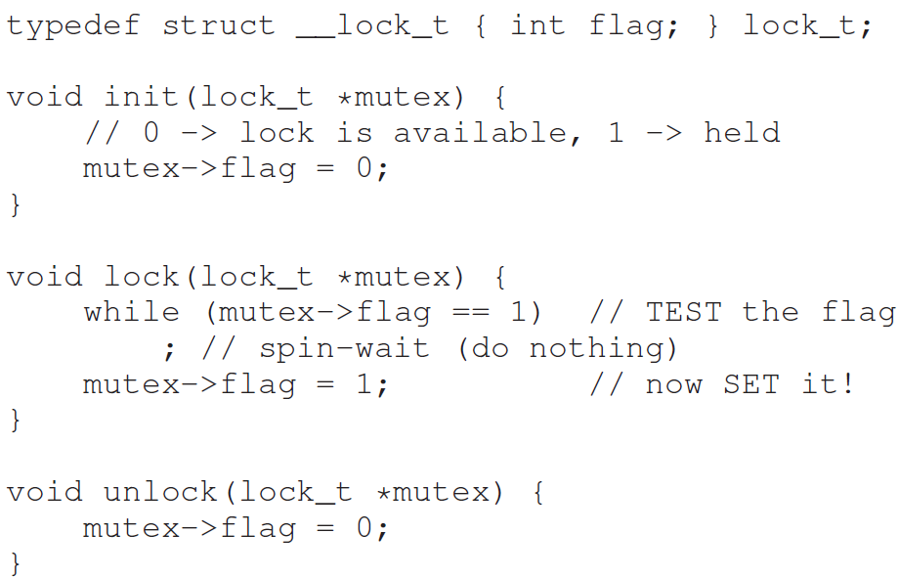
Go, change the world
RV College of
Engineering
Test and Set Instruction
To move beyond interrupt-based techniques, have to rely on CPU hardware and the instructions it provides to build a proper lock.
Ex: to build a simple lock by using a single flag variable. In this some of the basic ideas needed to build a lock is shown and also why just using a single variable and accessing it via normal loads and stores is insufficient is shown.
In this Figure 28.1, the idea is quite simple: use a simple variable (flag) to indicate whether some thread has possession of a lock. The first thread that enters the critical section will call lock(), which tests whether the flag is equal to 1 (in this case, it is not), and then sets the flag to 1 to indicate that the thread now holds the lock. When finished with the critical section, the thread calls unlock() and clears the flag, thus indicating that the lock is no longer held.
If another thread happens to call lock() while that first thread is in the critical section, it will simply spin-wait in the while loop for that thread to call unlock() and clear the flag.
Once that first thread does so, the waiting thread will fall out of the while loop, set the flag to 1 for itself, and proceed into the critical section.
Unfortunately, the code has two problems: one of correctness, and another is performance.

Slide 14
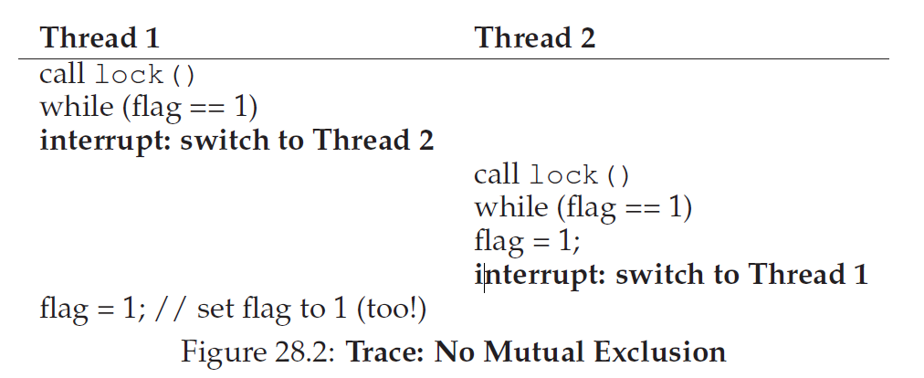
Go, change the world
Test and Set Instruction
RV College of
Engineering
Imagine the code interleaving in Figure 28.2; assume flag=0 to begin.
As shown from this interleaving, with timely (untimely?) interrupts, we can easily produce a case where both threads set the flag to 1 and both threads are thus able to enter the critical section.
This behavior failed to provide the most basic requirement: providing mutual exclusion.
The performance problem, is that the way a thread waits to acquire a lock that is already held: it endlessly checks the value of flag, a technique known as spin-waiting.
Spin-waiting wastes time waiting for another thread to release a lock.
The waste is exceptionally high on a uniprocessor, where the thread that the waiter is waiting for cannot even run (at least, until a context switch occurs)!
Hence need to develop more sophisticated solutions that should also consider ways to avoid this kind of waste.

Slide 15
Go, change the world
RV College of
Engineering
Peterson’s Solution
int flag[2];
int turn;
void init() {
// indicate you intend to hold the lock w/ ’flag’
flag[0] = flag[1] = 0;
// whose turn is it? (thread 0 or 1)
turn = 0;
}
void lock() {
// ’self’ is the thread ID of caller
flag[self] = 1;
// make it other thread’s turn
turn = 1 - self;
while ((flag[1-self] == 1) && (turn == 1 - self))
; // spin-wait while it’s not your turn
}
void unlock() {
// simply undo your intent
flag[self] = 0;
}
This line of work became quite useless when it was realized it is much easier to assume a little hardware support. Further, algorithms like the ones above don’t work on modern hardware (due to relaxed memory consistency models), thus making them even less useful than they were before.

Slide 16
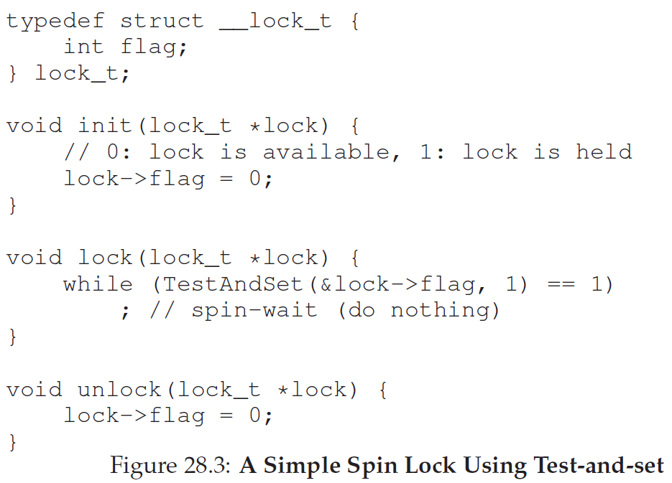
Go, change the world
Building Working Spin Locks with Test-And-Set
RV College of
Engineering
Because disabling interrupts does not work on multiple processors, and because simple approaches using loads and stores do not work, system designers started to invent hardware support for locking.
The simplest bit of hardware support is test-and-set (or atomic exchange) instruction.
testandset instruction is done via the following C code snippet:
int TestAndSet(int *old_ptr, int new)
{
int old = *old_ptr; // fetch old value at old_ptr
*old_ptr = new; // store ’new’ into old_ptr
return old; // return the old value
}

Slide 17
Building working spinlocks using TestandSet
test-and-set instruction returns the old value pointed to by the old ptr, and simultaneously updates said value to new.
The key, is that this sequence of operations is performed atomically.
The reason it is called “test and set” is that it enables you to “test” the old value (which is what is returned) while simultaneously “setting” the memory location to a new value.
Consider the first case where a thread calls lock() and no other thread currently holds the lock; thus, flag should be 0. When the thread calls TestAndSet(flag,1), the routine will return the old value of flag, which is 0; thus, the calling thread, which is testing the value of flag, will not get caught spinning in the while loop and will acquire the lock. The thread will also atomically set the value to 1, thus indicating that the lock is now held. When the thread is finished with its critical section, it calls unlock() to set the flag back to zero.
The second case arises when one thread already has the lock held (i.e., flag is 1). In this case, this thread will call lock() and
then call TestAndSet(flag, 1) as well. This time, TestAndSet() will return the old value at flag, which is 1 (because the lock is held), while simultaneously setting it to 1 again. As long as the lock is held by another thread, TestAndSet() will repeatedly return 1, and thus this thread will spin and spin until the lock is finally released. When the flag is finally set to 0 by some other thread, this thread will call TestAndSet() again, which will now return 0 while atomically setting the value to 1 and thus acquire the lock and enter the critical section. By making both the test (of the old lock value) and set (of the newvalue) a single atomic operation, we ensure that only one thread acquires the lock.
It might be clear why this type of lock is usually referred to as a spin lock. It is the simplest type of lock to build, and simply spins, using CPU cycles, until the lock becomes available.
To work correctly on a single processor, it requires a preemptive scheduler (i.e., one that will interrupt a thread via a timer, in order to run a different thread, from time to time). Without preemption, spin locks don’t make much sense on a single CPU, as a thread spinning on a CPU will never relinquish it.

Slide 18
Evaluating Spin Locks
Correctness: The spin lock only allows a single thread to enter the critical section at a time. Thus, we have a correct lock.
Fairness: Spin locks do not provide any fairness guarantees. Indeed, a thread spinning may spin forever, under contention. Simple spin locks are not fair and may lead to starvation.
Performance: To identify the costs of using a spin lock, consider a few different cases.
In the first, imagine threads competing for the lock on a single processor;
For spin locks, in the single CPU case, performance overheads can be quite painful; imagine the case where the thread holding the lock is preempted within a critical section. The scheduler might then run every other thread (imagine there are N − 1 others), each of which tries to acquire the lock. In this case, each of those threads will spin for the duration of a time slice before giving up the CPU, a waste of CPU cycles.
in the second, consider threads spread out across many CPUs.
However, on multiple CPUs, spin locks work reasonably well (if the number of threads roughly equals the number of CPUs). The thinking goes as follows: imagine Thread A on CPU 1 and Thread B on CPU 2, both contending for a lock. If Thread A (CPU 1) grabs the lock, and then Thread B tries to, B will spin (on CPU 2). However, presumably the critical section is short, and thus soon the lock becomes available, and is acquired by Thread B. Spinning to wait for a lock held on another processor doesn’t waste many cycles in this case, and thus can be effective.

Slide 19
Compare-And-Swap
Another hardware primitive that some systems provide is known as the compare-and-swap instruction (as it is called on SPARC, for example), or compare-and-exchange (as it called on x86).
The C pseudocode for this single instruction is
int CompareAndSwap(int *ptr, int expected, int new)
{
int original = *ptr;
if (original == expected)
*ptr = new;
return original;
}
Basic idea is for compare-and-swap to test whether the value at the address specified by ptr is equal to expected; if so, update the memory location pointed to by ptr with the new value. If not, do nothing. In either case, return the original value at that memory location, thus allowing the code calling compare-and-swap to know whether it succeeded or not.
With the compare-and-swap instruction, we can build a lock in a manner quite similar to that with test-and-set. For example, we could just replace the lock() routine above with the following:
void lock(lock_t *lock) {
while (CompareAndSwap(&lock->flag, 0, 1) == 1)
; // spin
}
The rest of the code is the same as the test-and-set example. This code works quite similarly; it simply checks if the flag is 0 and if so, atomically swaps in a 1 thus acquiring the lock. Threads that try to acquire the lock while it is held will get stuck spinning until the lock is finally released.

Slide 20
Load-Linked and Store-Conditional
Some platforms provide a pair of instructions that work in concert to help build critical sections. On the MIPS architecture [H93], for example, the load-linked and store-conditional instructions can be used in tandem to build locks and other concurrent structures.
The C pseudocode for these instructions is below. Alpha, PowerPC, and ARM provide similar instructions
int LoadLinked(int *ptr) {
return *ptr;
}
int StoreConditional(int *ptr, int value) {
if (no update to *ptr since LoadLinked to this address) {
*ptr = value;
return 1; // success!
} else {
return 0; // failed to update
}
}
The load-linked operates much like a typical load instruction, and simply fetches a value from memory and places it in a register. The key difference comes with the store-conditional, which only succeeds (and updates the value stored at the address just load-linked from) if no intervening store to the address has taken place. In the case of success, the storeconditional returns 1 and updates the value at ptr to value; if it fails, the value at ptr is not updated and 0 is returned.

Slide 21
Load-Linked and Store-Conditional
In the lock() code first, a thread spins waiting for the flag to be set to 0 (and thus indicate the lock is not held). Once so, the thread tries to acquire the lock via the store-conditional; if it succeeds, the thread has atomically changed the flag’s value to 1 and thus can proceed into the critical section.
Note how failure of the store-conditional might arise. One thread calls lock() and executes the load-linked, returning 0 as the lock is not held. Before it can attempt the store-conditional, it is interrupted and another thread enters the lock code, also executing the load-linked instruction, and also getting a 0 and continuing. At this point, two threads have each executed the load-linked and each are about to attempt the storeconditional.
void lock(lock_t *lock) {
while (1) {
while (LoadLinked(&lock->flag) == 1)
; // spin until it’s zero
if (StoreConditional(&lock->flag, 1) == 1)
return; // if set-it-to-1 was a success: all done
// otherwise: try it all over again
}
}
void unlock(lock_t *lock) {
lock->flag = 0;
}
Using LL/SC To Build A Lock
The key feature of these instructions is that only one of these threads will succeed in updating the flag to 1 and thus acquire the lock; the second thread to attempt the store-conditional will fail (because the other thread updated the value of flag between its load-linked and storeconditional) and thus have to try to acquire the lock again.
void lock(lock_t *lock) {
while (LoadLinked(&lock->flag) ||
!StoreConditional(&lock->flag, 1)) ; // spin }

Slide 22
Fetch-And-Add
One final hardware primitive is the fetch-and-add instruction, which atomically increments a value while
returning the old value at a particular address. The C pseudocode for the fetch-and-add instruction looks
like this: int FetchAndAdd(int *ptr) {
int old = *ptr;
*ptr = old + 1;
return old;
}
In this example, we’ll use fetch-and-add to build a more interesting ticket lock, as introduced by Mellor-Crummey and Scott.
Instead of a single value, this solution uses a ticket and turn variable in combination to build a lock. The basic operation is pretty simple: when a thread wishes to acquire a lock, it first does an atomic fetch-and-add on the ticket value; that value is now considered this thread’s “turn” (myturn). The globally shared lock->turn is then used to determine which thread’s turn it is; when (myturn == turn) for a given thread, it is that thread’s turn to enter the critical section. Unlock is accomplished simply by incrementing the turn such that the next waiting thread (if there is one) can now enter the critical section.
Note one important difference with this solution versus our previous attempts: it ensures progress for all threads. Once a thread is assigned its ticket value, it will be scheduled at some point in the future (once those in front of it have passed through the critical section and released the lock).
In our previous attempts, no such guarantee existed; a thread spinning on test-and-set (for example) could spin forever even as other threads acquire and release the lock.

Slide 23
Fetch-And-Add
typedef struct __lock_t
{
int ticket;
int turn;
} lock_t;
void lock_init(lock_t *lock)
{
lock->ticket = 0;
lock->turn = 0;
}
void lock(lock_t *lock) {
int myturn = FetchAndAdd(&lock->ticket);
while (lock->turn != myturn)
; // spin
}
void unlock(lock_t *lock) {
lock->turn = lock->turn + 1;
}
Ticket Locks

Slide 24
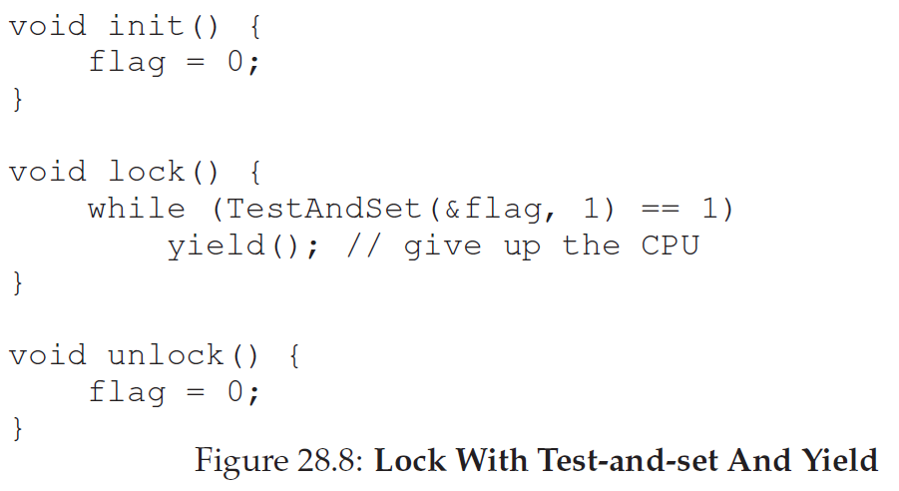
Go, change the world
RV College of
Engineering
Yield
Though Hardware support is efficient for working locks, and fairness in lock acquisition, problem arises when a context switch occurs in a critical section, and threads start to spin endlessly.
Simple approach is when it is going to spin, instead give up the CPU to another thread .
Yield is simply a system call that moves the caller from the running state to the ready state, and thus promotes another thread to running. Thus, the yielding process essentially deschedules itself.
Ex1: for 2threads on 1 CPU; yield works well. If a thread happens to call lock() and find a lock held, it will simply yield the CPU, and thus the other thread will run and finish its critical section.
Ex2: Many threads (say 100) contending for a lock repeatedly. If 1 thread acquires lock & is preempted before releasing it, the other 99 will each call lock(), find the lock held, and yield the CPU.
Assuming RR scheduler, each of the 99 will execute this run-and-yield pattern before the thread holding the lock gets to run again.
While better than spinning approach (which would waste 99 time slices spinning), this approach is still costly; the cost of a context switch can be substantial, and there is thus plenty of waste.
Worse, a thread may get caught in an endless yield loop while other threads repeatedly enter and exit the critical section.

Slide 25
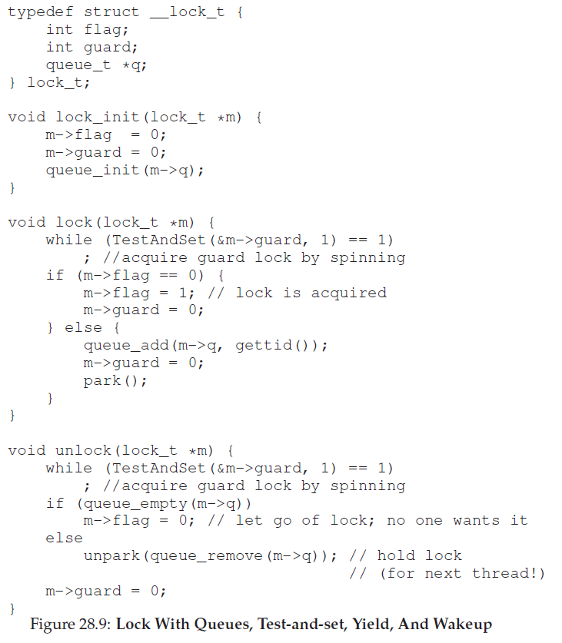
Go, change the world
RV College of
Engineering
Using Queues: Sleeping Instead Of Spinning
The real problem with previous approaches is that the scheduler determines which thread runs next; if it makes a bad choice, a thread runs that must either spin waiting for the lock or yield the CPU immediately. Either way, there is potential for waste and no prevention of starvation.
Thus, some control over which thread next gets to acquire the lock after the current holder releases it is what is needed.
This is achieved through OS support & a queue to keep track of which threads are waiting to acquire the lock.
The support is provided by Solaris, with 2 calls: park() to put a calling thread to sleep, and unpark(threadID) to wake a particular thread as designated by threadID.
These two routines can be used in tandem to build a lock that puts a caller to sleep if it tries to acquire a held lock and wakes it when the lock is free.

Slide 26
Go, change the world
RV College of
Engineering
Using Queues: Sleeping Instead Of Spinning
In the code,
The old test-and-set is combined with an explicit queue of lock waiters to make a more efficient lock.
A queue is used to help control who gets the lock next and thus avoid starvation.
The guard is used as a spin-lock around the flag and queue manipulations the lock is using. This approach thus doesn’t avoid spin-waiting entirely; a thread might be interrupted while acquiring or releasing the lock, and thus cause other threads to spin-wait for this one to run again.
However, the time spent spinning is quite limited (just a few instructions inside the lock and unlock code, instead of the user-defined critical section), and thus it may be reasonable.
In lock(), when a thread can not acquire the lock (it is already held), threads are added to a queue (by calling the gettid() function to get the thread ID of the current thread), set guard to 0, and yield the CPU.
What would happen if the release of the guard lock came after the park(), and not before?
The flag does not get set back to 0 when another thread gets woken up. Because when a thread is woken up, it will be as if it is returning from park(); however, it does not hold the guard at that point in the code and thus cannot even try to set the flag to 1.
Thus, the lock is directly passed from the thread releasing the lock to the next thread acquiring it; flag is not set to 0 in-between.

Slide 27
Go, change the world
RV College of
Engineering
Using Queues: Sleeping Instead Of Spinning
Finally, note the perceived race condition in the solution, just before the call to park(). With just the wrong timing, a thread will be about to park, assuming that it should sleep until the lock is no longer held. A switch at that time to another thread (say, a thread holding the lock) could lead to trouble.
EX: if that thread then released the lock. The subsequent park by the first thread would then sleep forever (potentially), a problem sometimes called the wakeup/waiting race.
Solaris solves this problem by adding a third system call: setpark().
By calling this routine, a thread can indicate it is about to park.
If it then happens to be interrupted and another thread calls unpark before park is actually called, the subsequent park returns immediately instead of sleeping.
The code modification, inside of lock(), is quite small:
queue_add(m->q, gettid());
setpark(); // new code
m->guard = 0;
A different solution could pass the guard into the kernel. In that case, the kernel could take precautions to atomically release the lock and dequeue the running thread.

Slide 28
Go, change the world
RV College of
Engineering
Different OS, Different Support
Linux provides a futex which is similar to the Solaris interface but provides more in-kernel functionality.
Specifically, each futex has associated with it a specific physical memory location, as well as a per-futex in-kernel queue.
Callers can use futex calls to sleep and wake as need be.
Specifically, two calls are available.
The call to futex wait(address, expected) puts the calling thread to sleep, assuming the value at address is equal to expected. If it is not equal, the call returns immediately.
The call to the routine futex wake(address)wakes one thread that is waiting on the queue.
This code snippet from lowlevellock.h in the nptl library (part of the gnu libc library) [L09] is interesting for a few reasons.
It uses a single integer to track both whether the lock is held or not (the high bit of the integer) and the number of waiters on the lock (all the other bits). Thus, if the lock is negative, it is held (because the high bit is set and that bit determines the sign of the integer).
The code snippet shows how to optimize for the common case, specifically when there is no contention for the lock; with only one thread acquiring and releasing a lock, very little work is done (the atomic bit test-and-set to lock and an atomic add to release the lock).

Slide 29
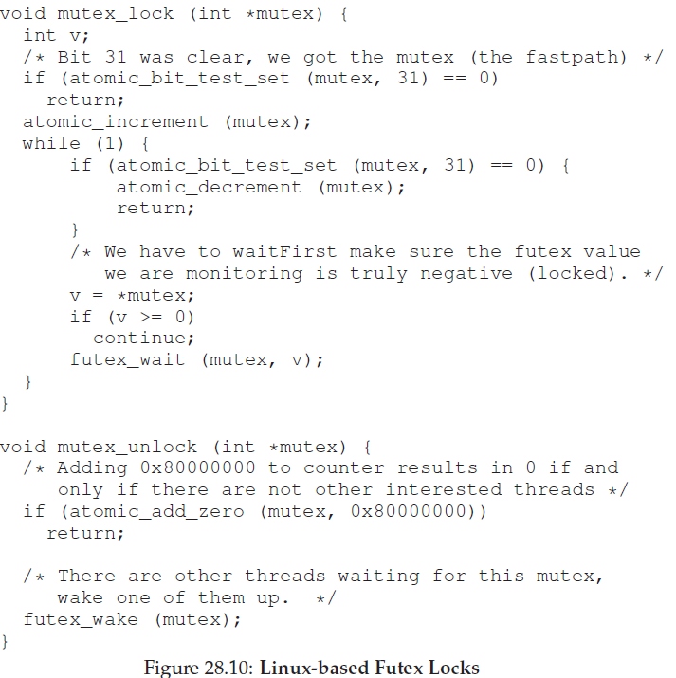
Linux Based Futex Locks

Slide 30
Go, change the world
RV College of
Engineering
Two-Phase Locks
Linux approach has the flavor of an old approach that has been used on and off for years, and is now referred to as a two-phase lock.
A two-phase lock realizes that spinning can be useful, particularly if the lock is about to be released.
So in the first phase, the lock spins for a while, hoping that it can acquire the lock.
However, if the lock is not acquired during the first spin phase, a second phase is entered, where the caller is put to sleep, and only woken up when the lock becomes free later.
The Linux lock is a form of such a lock, but it only spins once; a generalization of this could spin in a loop for a fixed amount of time before using futex support to sleep.
Two-phase locks are yet another instance of a hybrid approach, where combining two good ideas may indeed yield a better one.
Of course, whether it does depends strongly on many things, including the hardware environment, number of threads, and other workload details.
As always, making a single general-purpose lock, good for all possible use cases, is quite a challenge.

Slide 31
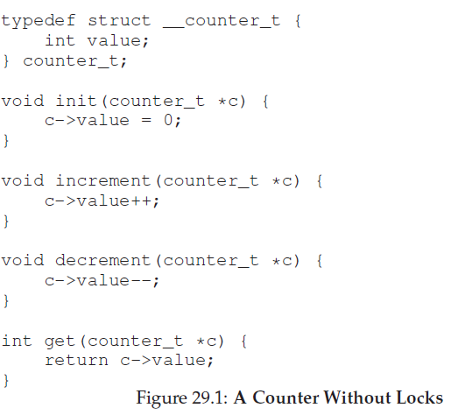
Go, change the world
RV College of
Engineering
Lock-based Concurrent Data Structures
Adding locks to a data structure to make it usable by threads makes the structure thread safe.
Exactly how such locks are added determines both the correctness and performance of the data structure. And thus, a challenge
Concurrent Counters
One of the simplest data structures is a counter. It is a structure that is commonly used and has a simple interface.
A simple nonconcurrent counter in Figure 29.1. Simple But Not Scalable
Non-synchronized counter is a trivial data structure, requiring a tiny amount of code to implement.
How to make this code thread safe?

Slide 32
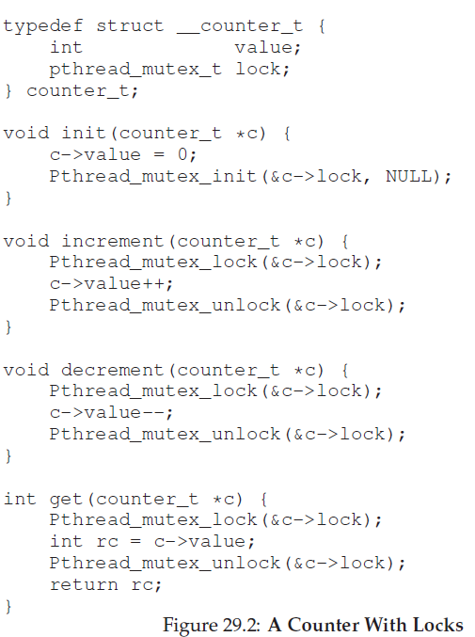
Go, change the world
RV College of
Engineering
Concurrent locks
This concurrent counter is simple and works correctly. In fact, it follows a design pattern common to the simplest and most basic concurrent data structures: it simply adds a single lock, which is acquired when calling a routine that manipulates the data structure, and is released when returning from the call.
The problem is performance. If the data structure is too slow, then more work is required than just adding a single lock.
If it is not too slow, you are done!

Slide 33
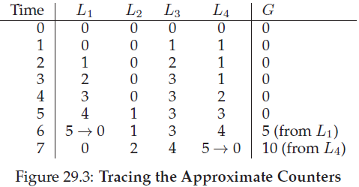
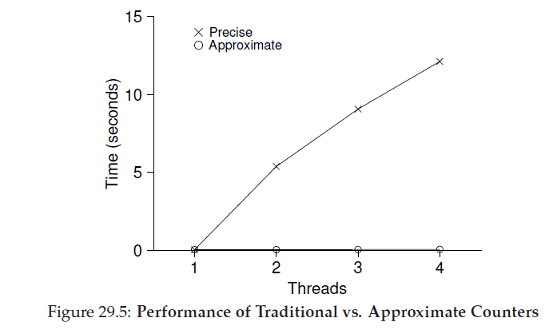
Go, change the world
RV College of
Engineering
Concurrent Locks
To understand the performance costs of the simple approach, a benchmark is ran in which each thread updates a single shared counter a fixed number of times; the number of threads are varied.
Figure 29.5 shows the total time taken, with 1-4threads active; each thread updates the counter one million times.
From the top line in the figure (labeled ’Precise’), it can be seen that the performance of the synchronized counter scales poorly.
Whereas 1 thread can complete the million counter updates in a tiny amount of time (roughly 0.03secs), 2 threads each update the counter one million times concurrently leads to a massive slowdown (taking over 5 secs!). It only gets worse with more threads.
Ideally, the threads must complete just as quickly on multiple processors as the single thread does on one. Achieving this end is called perfect scaling; even though more work is done, it is done in parallel, and hence the time taken to complete the task is not increased.

Slide 34
Go, change the world
RV College of
Engineering
Scalable Counting
Scalable counters matter, as recent work in OS performance analysis has shown without scalable counting, some workloads running on Linux suffer from serious scalability problems on multicore machines.
Many techniques have been developed to attack this problem.
One approach known as an approximate counter works by representing a single logical counter via numerous local physical counters, one per CPUcore, as well as a single global counter.
Specifically, on a machine with 4 CPUs, there are 4 local counters and one global one. In addition to these counters, there are also locks: one for each local counter, and one for the global counter.
The basic idea of approximate counting is as follows.
When a thread running on a given core wishes to increment the counter, it increments its local counter; access to this local counter is synchronized via the corresponding local lock.
Because each CPU has its own local counter, threads across CPUs can update local counters without contention, and thus updates to the counter are scalable.
However, to keep the global counter up to date (in case a thread wishes to read its value), the local values are periodically transferred to the global counter, by acquiring the global lock and incrementing it by the local counter’s value; the local counter is then reset to zero.
How often this local-to-global transfer occurs is determined by a threshold S. The smaller S is, the more the counter behaves like the non-scalable counter above; the bigger S is, the more scalable the counter, but the further off the global value might be from the actual count.
One could simply acquire all the local locks and the global lock (in a specified order, to avoid deadlock) to get an exact value, but that is not scalable.

Slide 35
Go, change the world
RV College of
Engineering
Scalable Counting
To make this clear, let’s look at an example (Figure 29.3).
In this example, the threshold S is set to 5, and there are threads on each of four CPUs updating their local counters L1 ... L4. The global counter value (G) is also shown in the trace, with time increasing downward.
At each time step, a local counter may be incremented; if the local value reaches the threshold S, the local value is transferred to the global counter and the local counter is reset.
The lower line in Figure 29.5 (labeled ’Approximate’) shows the performance of approximate counters with a threshold S of 1024.
Performance is excellent; the time taken to update the counter four million times on four processors is hardly higher than the time taken to update it one million times on one processor.

Slide 36
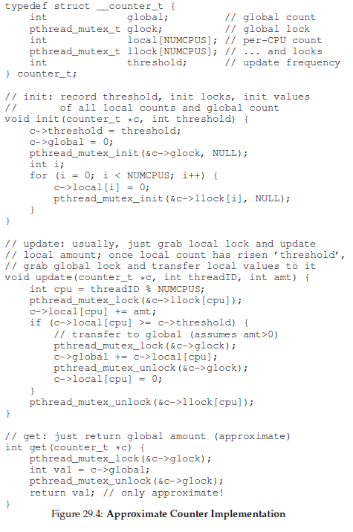
Go, change the world
RV College of
Engineering
Approximate Counter

Slide 37
Go, change the world
RV College of
Engineering
Concurrent Linked Lists
Begin with concurrent insert Figure 29.7 shows the code for this rudimentary data structure.
The code simply acquires a lock in the insert routine upon entry, and releases it upon exit.
One small tricky issue arises if malloc() happens to fail (a rare case); in this case, the code must also release the lock before failing the insert.
This kind of exceptional control flow has been shown to be quite error prone; a recent study of Linux kernel patches found that a huge fraction of bugs (nearly 40%) are found on such rarely-taken code paths (indeed, this observation sparked some of our own research, in which we removed all memory-failing paths from a Linux file system, resulting in amore robust system).
Thus, a challenge: can we rewrite the insert and lookup routines to remain correct under concurrent insert but avoid the case where the failure path also requires us to add the call to unlock?
The answer, in this case, is yes. Specifically, we can rearrange the code a bit so that the lock and release only surround the actual critical section in the insert code, and that a common exit path is used in the lookup code.
The former works because part of the lookup actually need not be locked; assuming that malloc() itself is thread-safe, each thread can call into it without worry of race conditions or other concurrency bugs. Only when updating the shared list does a lock need to be held. See Figure 29.8 for the details of these modifications.
As for the lookup routine, it’s a simple code transformation to jump out of main search loop to a single return path. Doing so again reduces the number of lock acquire/release points in the code, and thus decreases the chances of accidentally introducing bugs (such as forgetting to unlock before returning) into the code.

Slide 38
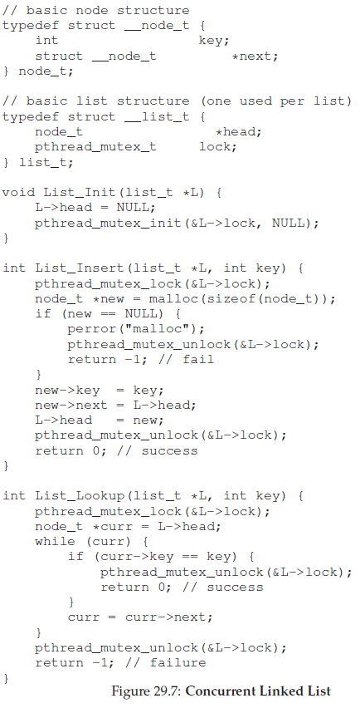
Go, change the world
RV College of
Engineering
Concurrent Linked Lists

Slide 39
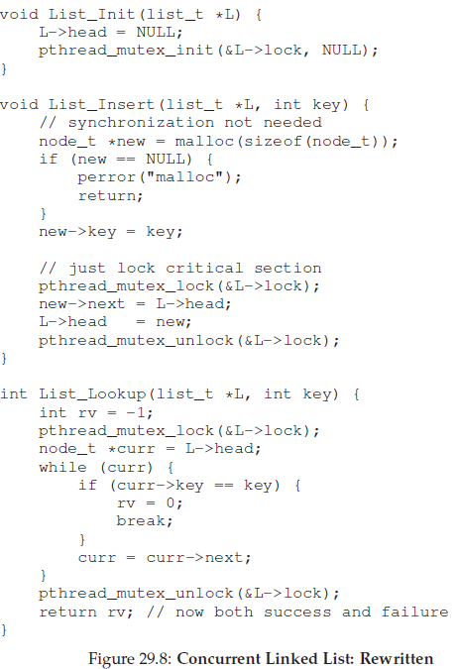
Go, change the world
RV College of
Engineering
Concurrent Linked Lists

Slide 40
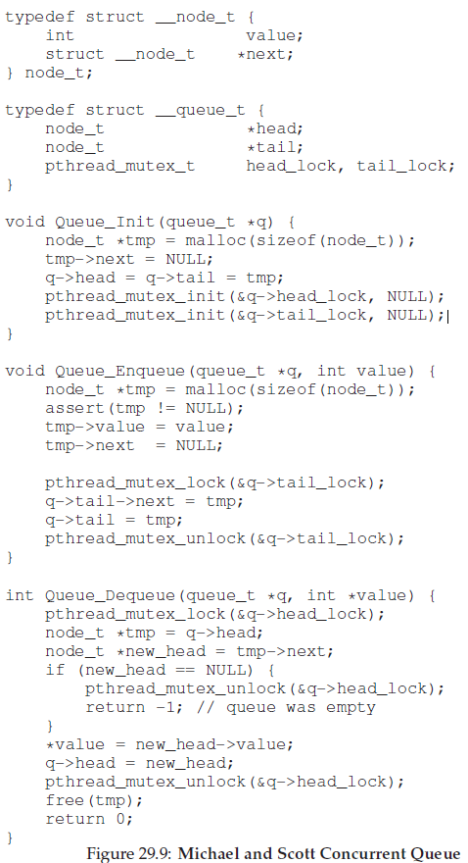
Go, change the world
RV College of
Engineering
Concurrent Queues

Slide 41
Go, change the world
RV College of
Engineering
Concurrent Queues
Concurrent queue designed by Michael and Scott [MS98].
There are two locks, one for the head of the queue, and one for the tail.
The goal of these two locks is to enable concurrency of enqueue and dequeue operations.
In the common case, the enqueue routine will only access the tail lock, and dequeue only the head lock.
One trick used by Michael and Scott is to add a dummy node (allocated in the queue initialization code); this dummy enables the separation of head and tail operations.

Slide 42
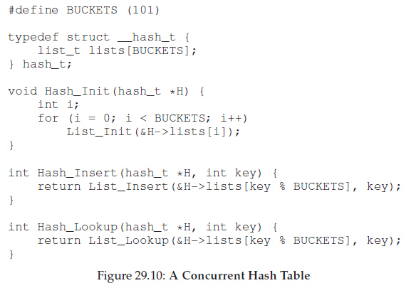
Go, change the world
RV College of
Engineering
Concurrent hashtable
This concurrent hash table (Figure 29.10) is straightforward, is built using the concurrent lists we developed earlier, and works incredibly well.
The reason for its good performance is that instead of having a single
lock for the entire structure, it uses a lock per hash bucket (each of which is represented by a list). Doing so enables many concurrent operations to take place.
Figure 29.11 shows the performance of the hash table under concurrent updates (from 10,000 to 50,000 concurrent updates from each of four threads, on the same iMac with four CPUs). Also shown, for the sake of comparison, is the performance of a linked list (with a single lock).
As you can see from the graph, this simple concurrent hash table scales magnificently; the linked list, in contrast, does not.

Slide 43
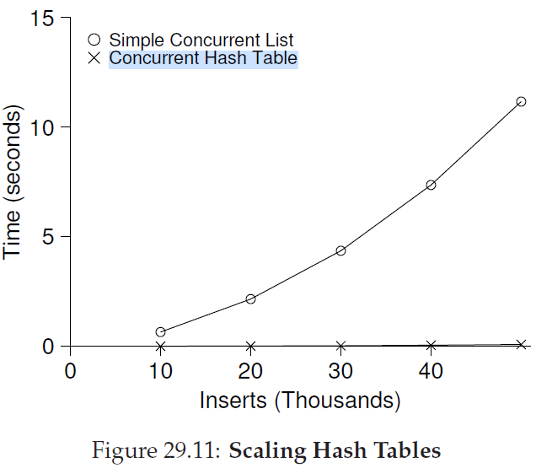
Go, change the world
RV College of
Engineering
Concurrent hashtable

